Slide 1
Develop Artificial Intelligence for Playing Tic-Tac-Toe Game
Project 01
01 |

Slide 2





Project 01

Slide 3
TABLE OF CONTENS
001
Implementing The XO Game in Python using OOP
002
Creating an AI opponent
003
Testing the Efficacy of The AI
004
Deployment The Game to Web
Project 01
get to know the rule of the game and how to implement it.
By using two types of algorithm
using Flask framework with HTML and CSS to deploy our game to web

Slide 4
Implementing The XO Game in Python using OOP
Project 01
001
get to know the rule of the game and how to implement it.

Slide 5
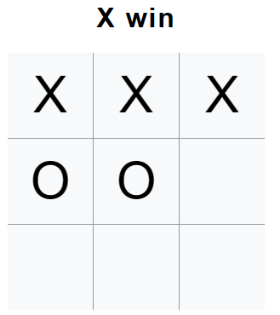
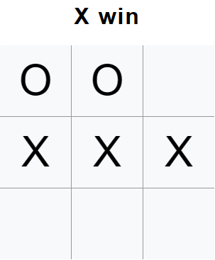
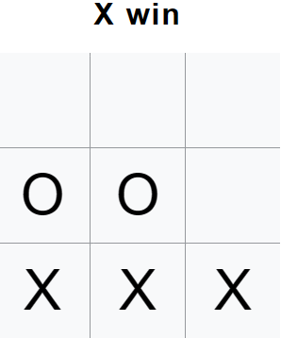

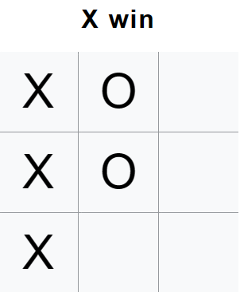
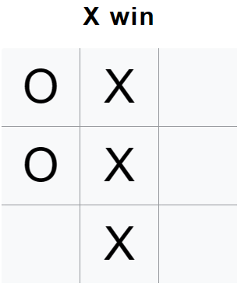
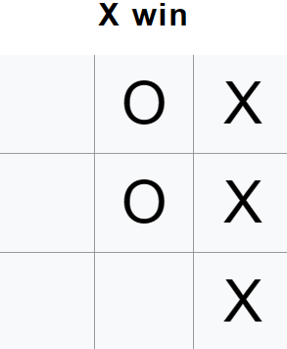
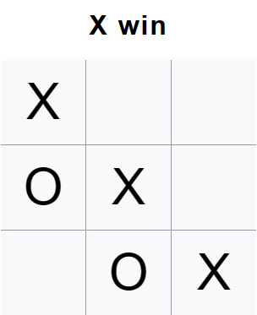
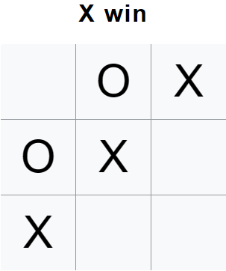
Implementing The XO Game in Python using OOP
Project 01
001
get to know the rule of the game and how to implement it.
X
O
[0,1,2], [3,4,5], [6,7,8]
[0,3,6], [1,4,7],[2,5,8]
[0,4,8], [2,4,6]

Slide 6
Implementing The XO Game in Python using OOP
Project 01
001
get to know the rule of the game and how to implement it.
# list that contanin all posible positions to win the game (two-dimensional list 8 rows 3 columns)
winning_combinations = [[0,1,2], [3,4,5], [6,7,8],
[0,3,6], [1,4,7], [2,5,8],
[0,4,8], [2,4,6]]

Slide 7
Implementing The XO Game in Python using OOP
Project 01
001
get to know the rule of the game and how to implement it.
class Board:
''' The Board class represents the game board and state of the game in the Tic-Tac-Toe game.
It has a 9x1 numpy array representing the game board, which is initially set to all zeros.
It also has lists to store the positions marked by player 1 (X) and player 2 (O) on the game board
and a list of valid moves that can be made on the game board
'''

Slide 8
Implementing The XO Game in Python using OOP
Project 01
001
get to know the rule of the game and how to implement it.
class Board:
''' '''
def __init__(self):
self.board = np.zeros((9,)).astype(int)
self.o_positions = []
self.x_positions = []
self.valid_moves = list(set(range(9)))
...

Slide 9
Implementing The XO Game in Python using OOP
Project 01
001
get to know the rule of the game and how to implement it.
class Board:
...
def mark_down(self, action, player):
''' Marks the given position with the symbol of the given player on the game board
'''
self.board[action] = player
# update positions(index) on the board of each symbol
self.x_positions = [i for i,j in enumerate(self.board) if j == 1]
self.o_positions = [i for i,j in enumerate(self.board) if j == 2]
# update the valid moves (avalible moves)
self.valid_moves = list(set(range(9)) - set(self.x_positions + self.o_positions))
...

Slide 10
Implementing The XO Game in Python using OOP
Project 01
001
get to know the rule of the game and how to implement it.
class Board:
...
def is_final_state(self):
''' check if the current state is a final state (reach terminal state) then return the result
@return 0 if there is no win yet
@return 1 if player 1 win (X)
@return 2 if player 2 win (O)
This is an excellent method to adapt to AI later especially Agent Minimax
'''
...

Slide 11
Implementing The XO Game in Python using OOP
Project 01
001
get to know the rule of the game and how to implement it.
class Board:
...
def is_final_state(self):
''' '''
# check win X
for win in winning_combinations:
if all(p in self.x_positions for p in win):
return 1
# check win O
for win in winning_combinations:
if all(p in self.o_positions for p in win):
return 2
# no win yet
return 0
...

Slide 12
Implementing The XO Game in Python using OOP
Project 01
001
get to know the rule of the game and how to implement it.
class Board:
...
def display_board(self):
''' display a board on the console (display only using for testing or debuging)
'''
# copy the current board then change copy board type from int to str
curr_board = copy.deepcopy(self.board)
curr_board = curr_board.astype(str)
# loop through the copy board to assign symbol
for i in range(len(curr_board)):
if curr_board[i] == "1":
curr_board[i] = "X"
elif curr_board[i] == "2":
curr_board[i] = "O"
else:
curr_board[i] = "_"
print(curr_board.reshape([3,3]))
...

Slide 13
Implementing The XO Game in Python using OOP
Project 01
001
get to know the rule of the game and how to implement it.
class Board:
...
# Two methods below is using for deploy on web
def get_board(self): # same method as display_board but return board not print
...
return curr_board
def check_valid(self, poss):
temp = self.get_board()
if temp[poss] == "":
return True

Slide 14
Implementing The XO Game in Python using OOP
Project 01
001
get to know the rule of the game and how to implement it.
class Game:
''' This class provides method to play and manupulate the game'''
def __init__(self):
self.board = Board() # creating board's object
self.player = 1 # assign the initial player to 1 that means X always plays first
self.running = True
#self.board.display_board() # display initial board on terminal (for testing or debuging)
...

Slide 15
Implementing The XO Game in Python using OOP
Project 01
001
get to know the rule of the game and how to implement it.
class Game:
...
def make_move(self, action):
''' This method Makes a move on the game board and checks if the game has ended.'''
# call mark down for make move
self.board.mark_down(action, self.player)
#self.board.display_board() # display the board (for testing or debuging)
# checks if the game has ended
self.check_end()
# Switches to the next player's turn.
self.next_turn()
...

Slide 16
Implementing The XO Game in Python using OOP
Project 01
001
get to know the rule of the game and how to implement it.
class Game:
...
def check_end(self):
global head # head using for web version
case = self.board.is_final_state()
if case == 1:
#print("X win")
head = "X win"
self.running = False
elif case == 2:
#print("O win")
head = "O win"
self.running = False
elif len(self.board.valid_moves) == 0:
#print("Draw")
head = "Draw"
self.running = False
...

Slide 17
Implementing The XO Game in Python using OOP
Project 01
001
get to know the rule of the game and how to implement it.
class Game:
...
def next_turn(self):
self.player = self.player % 2 + 1
def reset(self):
''' Reset the game'''
self.__init__()

Slide 18
Implementing The XO Game in Python using OOP
Project 01
001
get to know the rule of the game and how to implement it.
def human(board):
''' Using for playing on console only '''
move = int(input("เลือกช่อง 1-9: ")) - 1
while move not in board.valid_moves:
move = int(input("! กรุณาเลือกช่อง 1-9 !: ")) - 1
return move
def rnd_bot(board):
''' Create a random bot that chooses a random position from current valid moves'''
valid_moves = board.valid_moves
# avoid it from random the None list
if len(valid_moves) != 0:
return random.choice(valid_moves)
return None
def testing():
game = Game()
board = game.board while 1:
if game.running == True:
game.make_move(human(board))
print()
game.make_move(rnd_bot(board))
else:
print("----------------------------")
game.reset()
board = game.board
testing()

Slide 19
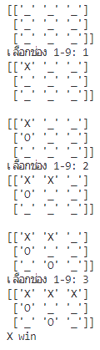
Implementing The XO Game in Python using OOP
Project 01
001
get to know the rule of the game and how to implement it.
def human(board):
''' Using for playing on console only '''
move = int(input("เลือกช่อง 1-9: ")) - 1
while move not in board.valid_moves:
move = int(input("! กรุณาเลือกช่อง 1-9 !: ")) - 1
return move
def rnd_bot(board):
''' Create a random bot that chooses a random position from current valid moves'''
valid_moves = board.valid_moves
# avoid it from random the None list
if len(valid_moves) != 0:
return random.choice(valid_moves)
return None
def testing():
game = Game()
board = game.board while 1:
if game.running == True:
game.make_move(human(board))
print()
game.make_move(rnd_bot(board))
else:
print("----------------------------")
game.reset()
board = game.board
testing()

Slide 20
Creating an AI opponent
Project 01
002
By using two types of algorithm

Slide 21
Creating an AI opponent
Project 01
002
By using two types of algorithm
Agent MaxV

Slide 22
Creating an AI opponent
Project 01
002
By using
Agent MaxV

Slide 23
Creating an AI opponent
Project 01
002
By using
Agent MaxV
class AgentMaxV:
''' The AgentMax class is an AI agent that plays Tic-Tac-Toe by using an objective function
it chooses the action that gives the highest score from the function called the V function
The formula to calculate V functions is
V(b) = X(b) - O(b) + 1
X(b) is the summation of X symbols in the board that hasn't any O symbol in each line
O(b) is the summation of the O symbols in the board that hasn't any X symbol in each line
'''
def __init__(self, board, player):
self.board = board
self.player = player
def determine_side(self):
''' determines which positions on the game board belong to the agent's player
and which belong to the opponent.
'''
# if it's play as X
if self.player == 1:
self.side = self.board.x_positions
self.opp = self.board.o_positions
# if it's play as O
else:
self.side = self.board.o_positions
self.opp = self.board.x_positions
...

Slide 24
Creating an AI opponent
Project 01
002
By using
Agent MaxV
class AgentMaxV:
...
def eval(self, temp_move):
''' Calculate V function'''
opp_val, self_val, critical_moves = self.cal_val(temp_move)
return self_val - opp_val + 1, critical_moves
def cal_val(self, temp_move):
''' Calculate the score of each symbol that meet the conditions '''
opp_val = self_val = 0
critical_moves = []
for win in winning_combinations:
self_count = [i in temp_move for i in win]
opp_count = [i in self.opp for i in win]
# Calculate other score
if not any(self_count):
temp_opp_count = opp_count.count(True)
opp_val += temp_opp_count
# If current state has the criticalmove
if temp_opp_count == 2:
critical_moves = win
# Calculate self score
if not any(opp_count):
self_val += self_count.count(True)
return opp_val, self_val, critical_moves
...

Slide 25
Creating an AI opponent
Project 01
002
By using
Agent MaxV
class AgentMaxV:
...
def eval(self, temp_move):
''' Calculate V function'''
opp_val, self_val, critical_moves = self.cal_val(temp_move)
return self_val - opp_val + 1, critical_moves
def cal_val(self, temp_move):
''' Calculate the score of each symbol that meet the conditions '''
opp_val = self_val = 0
critical_moves = []
for win in winning_combinations:
self_count = [i in temp_move for i in win]
opp_count = [i in self.opp for i in win]
# Calculate other score
if not any(self_count):
temp_opp_count = opp_count.count(True)
opp_val += temp_opp_count
# If current state has the criticalmove
if temp_opp_count == 2:
critical_moves = win
# Calculate self score
if not any(opp_count):
self_val += self_count.count(True)
return opp_val, self_val, critical_moves
...
V(b) = X(b) – O(b) + 1

Slide 26
Creating an AI opponent
Project 01
002
By using
Agent MaxV
class AgentMaxV:
...
def eval(self, temp_move):
''' Calculate V function'''
opp_val, self_val, critical_moves = self.cal_val(temp_move)
return self_val - opp_val + 1, critical_moves
def cal_val(self, temp_move):
''' Calculate the score of each symbol that meet the conditions '''
opp_val = self_val = 0
critical_moves = []
for win in winning_combinations:
self_count = [i in temp_move for i in win]
opp_count = [i in self.opp for i in win]
# Calculate other score
if not any(self_count):
temp_opp_count = opp_count.count(True)
opp_val += temp_opp_count
# If current state has the criticalmove
if temp_opp_count == 2:
critical_moves = win
# Calculate self score
if not any(opp_count):
self_val += self_count.count(True)
return opp_val, self_val, critical_moves
...
V(b) = X(b) – O(b) + 1
X(b) is the summation of X symbols in the board
that hasn't any O symbol in each line
O(b) is the summation of the O symbols in the board
that hasn't any X symbol in each line

Slide 27
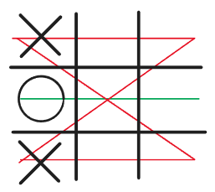
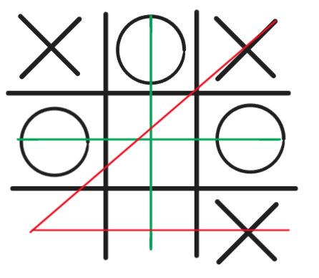
Creating an AI opponent
Project 01
002
By using
Agent MaxV
class AgentMaxV:
...
def eval(self, temp_move):
''' Calculate V function'''
opp_val, self_val, critical_moves = self.cal_val(temp_move)
return self_val - opp_val + 1, critical_moves
def cal_val(self, temp_move):
''' Calculate the score of each symbol that meet the conditions '''
opp_val = self_val = 0
critical_moves = []
for win in winning_combinations:
self_count = [i in temp_move for i in win]
opp_count = [i in self.opp for i in win]
# Calculate other score
if not any(self_count):
temp_opp_count = opp_count.count(True)
opp_val += temp_opp_count
# If current state has the criticalmove
if temp_opp_count == 2:
critical_moves = win
# Calculate self score
if not any(opp_count):
self_val += self_count.count(True)
return opp_val, self_val, critical_moves
...
V(b) = X(b) – O(b) + 1
X(b) is the summation of X symbols in the board
that hasn't any O symbol in each line
O(b) is the summation of the O symbols in the board
that hasn't any X symbol in each line
V = (1+1+1+1) – 1 + 1 = 4
V = (1+1) – (2+1) + 1 = 0

Slide 28
Creating an AI opponent
Project 01
002
By using
Agent MaxV
class AgentMaxV:
...
def play(self):
''' determines the next move to make by evaluating the potential value of each possible move
and choosing the move that maximizes the value.
'''
self.determine_side()
valid_moves = self.board.valid_moves
V = [-100] * 9 # Create a list V to store each value from each move
# Try every possible move to find the best move (the move that give highest value)
for move in valid_moves:
temp_move = self.side + [move]
# calculate a value of the move position by calling evaluate the function then store it in V
V[move], critical_moves = self.eval(temp_move)
# the critical move is the list that stores the positions that can make the opposite win in the next turn
if len(critical_moves) > 2:
# we don't want to let the opposite win so we will block it!
moves = [move for move in critical_moves if move in valid_moves]
return random.choice(moves)
# chose the best moves
maxV = max(V)
# find all the index that value is equal to maxV
ibest_moves = [move for move,value in enumerate(V) if value == maxV]
return random.choice(ibest_moves)

Slide 29
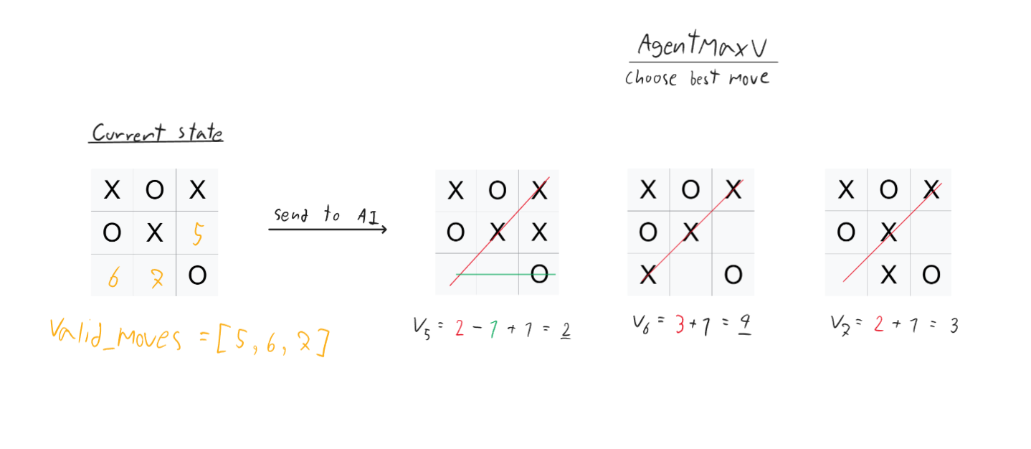
Creating an AI opponent
Project 01
002
By using
Agent MaxV
class AgentMaxV:
...
def play(self):
''' determines the next move to make by evaluating the potential value of each possible move
and choosing the move that maximizes the value.
'''
self.determine_side()
valid_moves = self.board.valid_moves
V = [-100] * 9 # Create a list V to store each value from each move
# Try every possible move to find the best move (the move that give highest value)
for move in valid_moves:
temp_move = self.side + [move]
# calculate a value of the move position by calling evaluate the function then store it in V
V[move], critical_moves = self.eval(temp_move)
# the critical move is the list that stores the positions that can make the opposite win in the next turn
if len(critical_moves) > 2:
# we don't want to let the opposite win so we will block it!
moves = [move for move in critical_moves if move in valid_moves]
return random.choice(moves)
# chose the best moves
maxV = max(V)
# find all the index that value is equal to maxV
ibest_moves = [move for move,value in enumerate(V) if value == maxV]
return random.choice(ibest_moves)

Slide 30
Creating an AI opponent
Project 01
002
By using
Agent MaxV
class AgentMaxV:
...
def play(self):
''' determines the next move to make by evaluating the potential value of each possible move
and choosing the move that maximizes the value.
'''
self.determine_side()
valid_moves = self.board.valid_moves
V = [-100] * 9 # Create a list V to store each value from each move
# Try every possible move to find the best move (the move that give highest value)
for move in valid_moves:
temp_move = self.side + [move]
# calculate a value of the move position by calling evaluate the function then store it in V
V[move], critical_moves = self.eval(temp_move)
# the critical move is the list that stores the positions that can make the opposite win in the next turn
if len(critical_moves) > 2:
# we don't want to let the opposite win so we will block it!
moves = [move for move in critical_moves if move in valid_moves]
return random.choice(moves)
# chose the best moves
maxV = max(V)
# find all the index that value is equal to maxV
ibest_moves = [move for move,value in enumerate(V) if value == maxV]
return random.choice(ibest_moves)

Slide 31
Creating an AI opponent
Project 01
002
By using
Agent MaxV
class AgentMaxV:
...
def play(self):
''' determines the next move to make by evaluating the potential value of each possible move
and choosing the move that maximizes the value.
'''
self.determine_side()
valid_moves = self.board.valid_moves
V = [-100] * 9 # Create a list V to store each value from each move
# Try every possible move to find the best move (the move that give highest value)
for move in valid_moves:
temp_move = self.side + [move]
# calculate a value of the move position by calling evaluate the function then store it in V
V[move], critical_moves = self.eval(temp_move)
# the critical move is the list that stores the positions that can make the opposite win in the next turn
if len(critical_moves) > 2:
# we don't want to let the opposite win so we will block it!
moves = [move for move in critical_moves if move in valid_moves]
return random.choice(moves)
# chose the best moves
maxV = max(V)
# find all the index that value is equal to maxV
ibest_moves = [move for move,value in enumerate(V) if value == maxV]
return random.choice(ibest_moves)

Slide 32
Creating an AI opponent
Project 01
002
By using two types of algorithm
Agent Minimax

Slide 33
Creating an AI opponent
Project 01
002
By using
Agent Minimax
class AgentMinimax:
''' An AI agent that plays Tic-Tac-Toe using the minimax algorithm which is a Backtracking Algorithm
that is used in decision-making to find the optimal move for a player in a two-player game.
It works by using recursive function called minimax to explore all the possible moves and game states in the game tree,
starting from the root node (which represents the current state of the game)
and going all the way down to the leaf nodes (which represent the final stages of the game) for considering the scores of all possible moves at each step
'''
def __init__(self,board, player):
self.board = board
self.player = player
def minimax(self, board, maximizing):
''' This is the core recursive function of the minimax algorithm.
At each node of the tree, the algorithm determines the optimal move for the current player,
these returned scores determine the optimal move for the current player at the current node.
If the agent is trying to maximize their score, it will choose the move that leads to the child node with the highest score.
If the agent is trying to minimize the score of their opponent, it will choose the move that leads to the child node with the lowest score.
it will continue recursively until reaches the terminal state
'''
...

Slide 34
Creating an AI opponent
Project 01
002
By using
Agent Minimax
class AgentMinimax:
...
def minimax(self, board, maximizing):
''' '''
# check if reach the terminal case
case = board.is_final_state()
# player 1 wins
if case == 1:
return 1, None
# player 2 wins
if case == 2:
return -1, None
# draw
elif len(board.valid_moves) == 0:
return 0, None
...

Slide 35
Creating an AI opponent
Project 01
002
By using
Agent Minimax
class AgentMinimax:
...
def minimax(self, board, maximizing):
...
# X's turn
if maximizing:
max_eval = -100
best_move = None
valid_moves = board.valid_moves
for move in valid_moves:
temp_board = copy.deepcopy(board)
temp_board.mark_down(move, 1)
eval = self.minimax(temp_board, False)[0]
if eval > max_eval:
max_eval = eval
best_move = move
return max_eval, best_move
...
...
class AgentMinimax:
...
def minimax(self, board, maximizing):
...
# O's trun
elif not maximizing:
min_eval = 100
best_move = None
valid_moves = board.valid_moves
for move in valid_moves:
temp_board = copy.deepcopy(board)
temp_board.mark_down(move, 2)
#temp_board.display_board()
eval = self.minimax(temp_board, True)[0]
if eval < min_eval:
min_eval = eval
best_move = move
return min_eval, best_move
...

Slide 36
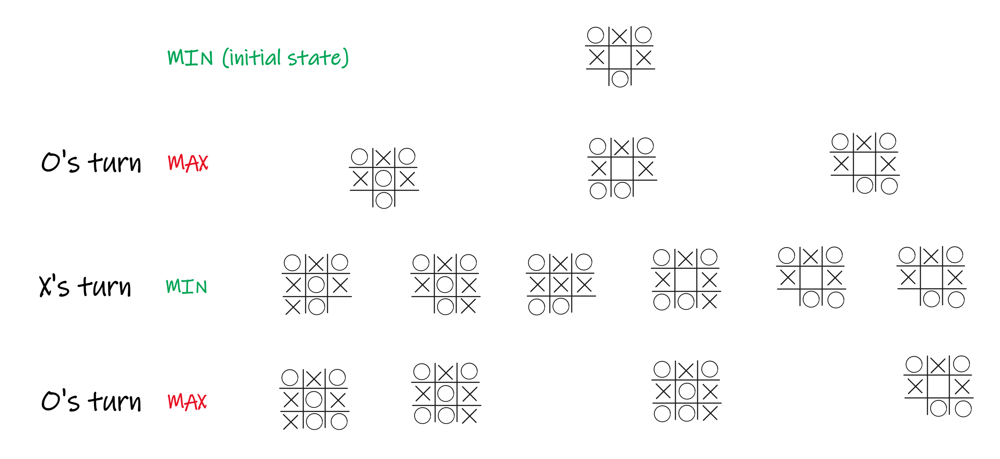
Creating an AI opponent
Project 01
002
By using
Agent Minimax
class AgentMinimax:
...
def minimax(self, board, maximizing):
...
# X's turn
if maximizing:
max_eval = -100
best_move = None
valid_moves = board.valid_moves
for move in valid_moves:
temp_board = copy.deepcopy(board)
temp_board.mark_down(move, 1)
eval = self.minimax(temp_board, False)[0]
if eval > max_eval:
max_eval = eval
best_move = move
return max_eval, best_move
...
...
class AgentMinimax:
...
def minimax(self, board, maximizing):
...
# O's trun
elif not maximizing:
min_eval = 100
best_move = None
valid_moves = board.valid_moves
for move in valid_moves:
temp_board = copy.deepcopy(board)
temp_board.mark_down(move, 2)
#temp_board.display_board()
eval = self.minimax(temp_board, True)[0]
if eval < min_eval:
min_eval = eval
best_move = move
return min_eval, best_move
...

Slide 37
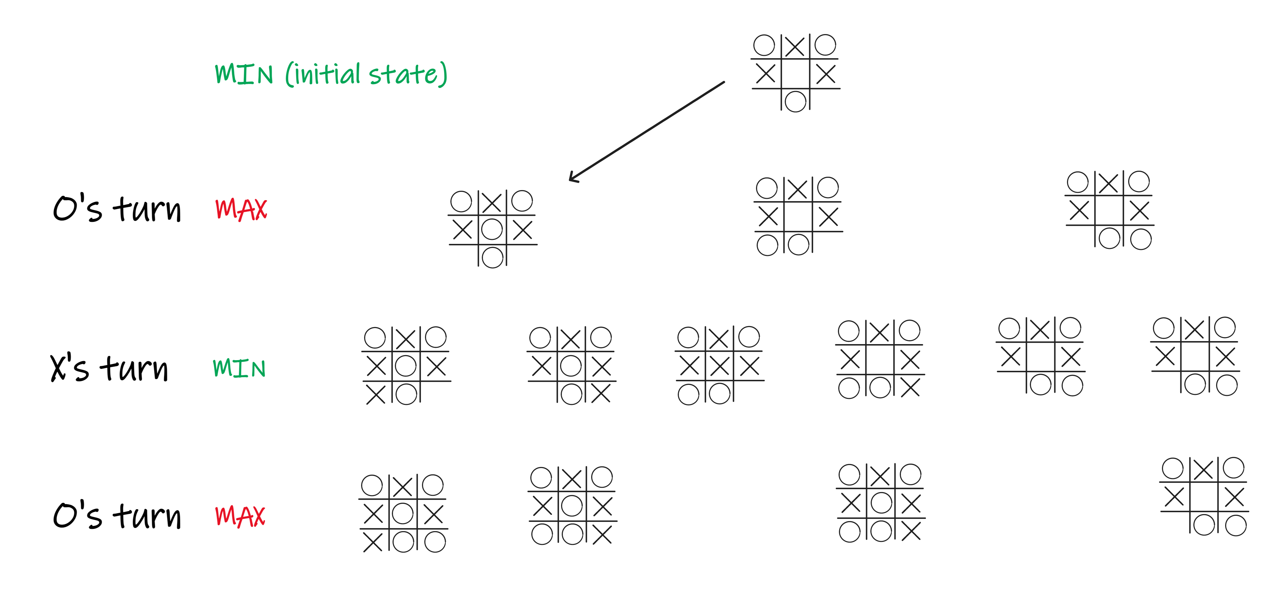
Creating an AI opponent
Project 01
002
By using
Agent Minimax
class AgentMinimax:
...
def minimax(self, board, maximizing):
...
# X's turn
if maximizing:
max_eval = -100
best_move = None
valid_moves = board.valid_moves
for move in valid_moves:
temp_board = copy.deepcopy(board)
temp_board.mark_down(move, 1)
eval = self.minimax(temp_board, False)[0]
if eval > max_eval:
max_eval = eval
best_move = move
return max_eval, best_move
...
...
class AgentMinimax:
...
def minimax(self, board, maximizing):
...
# O's trun
elif not maximizing:
min_eval = 100
best_move = None
valid_moves = board.valid_moves
for move in valid_moves:
temp_board = copy.deepcopy(board)
temp_board.mark_down(move, 2)
#temp_board.display_board()
eval = self.minimax(temp_board, True)[0]
if eval < min_eval:
min_eval = eval
best_move = move
return min_eval, best_move
...

Slide 38
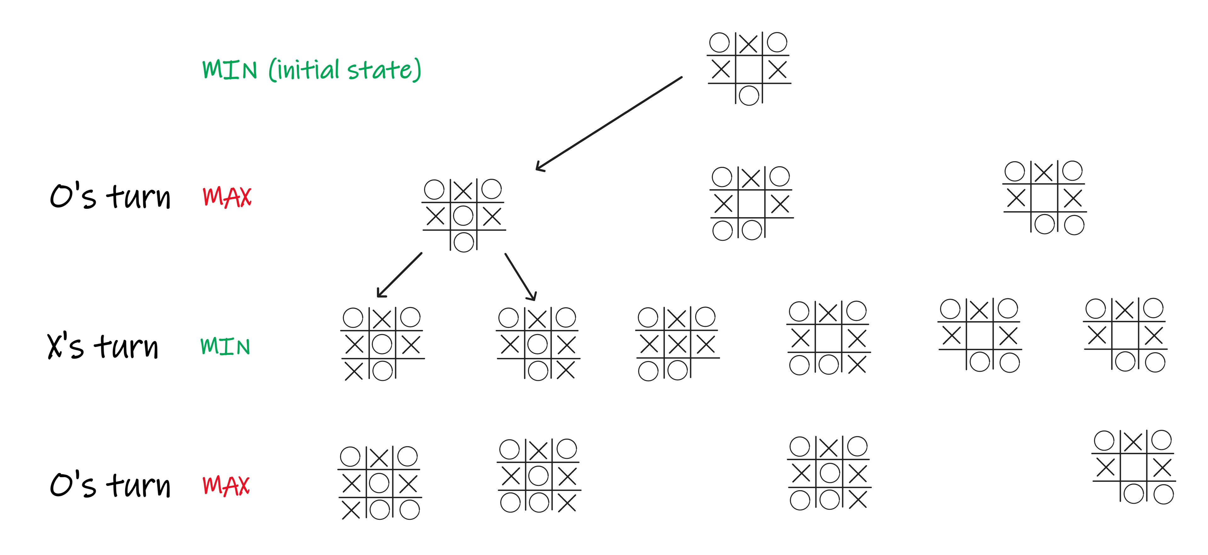
Creating an AI opponent
Project 01
002
By using
Agent Minimax
class AgentMinimax:
...
def minimax(self, board, maximizing):
...
# X's turn
if maximizing:
max_eval = -100
best_move = None
valid_moves = board.valid_moves
for move in valid_moves:
temp_board = copy.deepcopy(board)
temp_board.mark_down(move, 1)
eval = self.minimax(temp_board, False)[0]
if eval > max_eval:
max_eval = eval
best_move = move
return max_eval, best_move
...
...
class AgentMinimax:
...
def minimax(self, board, maximizing):
...
# O's trun
elif not maximizing:
min_eval = 100
best_move = None
valid_moves = board.valid_moves
for move in valid_moves:
temp_board = copy.deepcopy(board)
temp_board.mark_down(move, 2)
#temp_board.display_board()
eval = self.minimax(temp_board, True)[0]
if eval < min_eval:
min_eval = eval
best_move = move
return min_eval, best_move
...

Slide 39
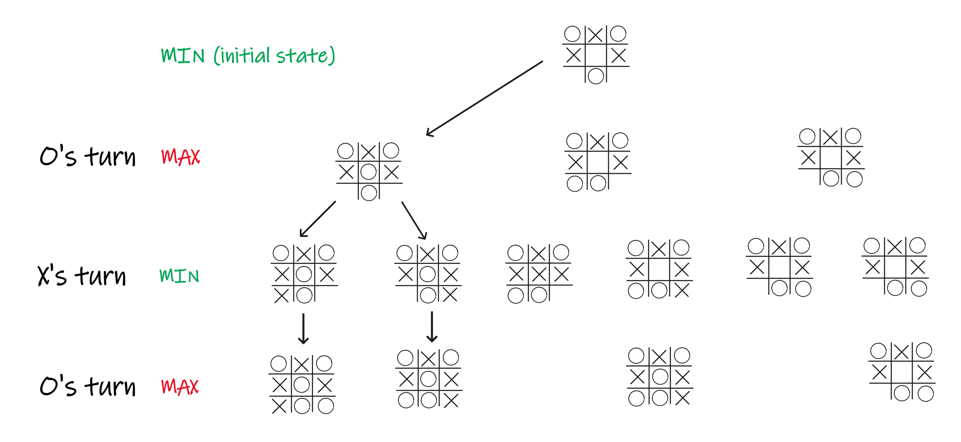
Creating an AI opponent
Project 01
002
By using
Agent Minimax
class AgentMinimax:
...
def minimax(self, board, maximizing):
...
# X's turn
if maximizing:
max_eval = -100
best_move = None
valid_moves = board.valid_moves
for move in valid_moves:
temp_board = copy.deepcopy(board)
temp_board.mark_down(move, 1)
eval = self.minimax(temp_board, False)[0]
if eval > max_eval:
max_eval = eval
best_move = move
return max_eval, best_move
...
...
class AgentMinimax:
...
def minimax(self, board, maximizing):
...
# O's trun
elif not maximizing:
min_eval = 100
best_move = None
valid_moves = board.valid_moves
for move in valid_moves:
temp_board = copy.deepcopy(board)
temp_board.mark_down(move, 2)
#temp_board.display_board()
eval = self.minimax(temp_board, True)[0]
if eval < min_eval:
min_eval = eval
best_move = move
return min_eval, best_move
...

Slide 40
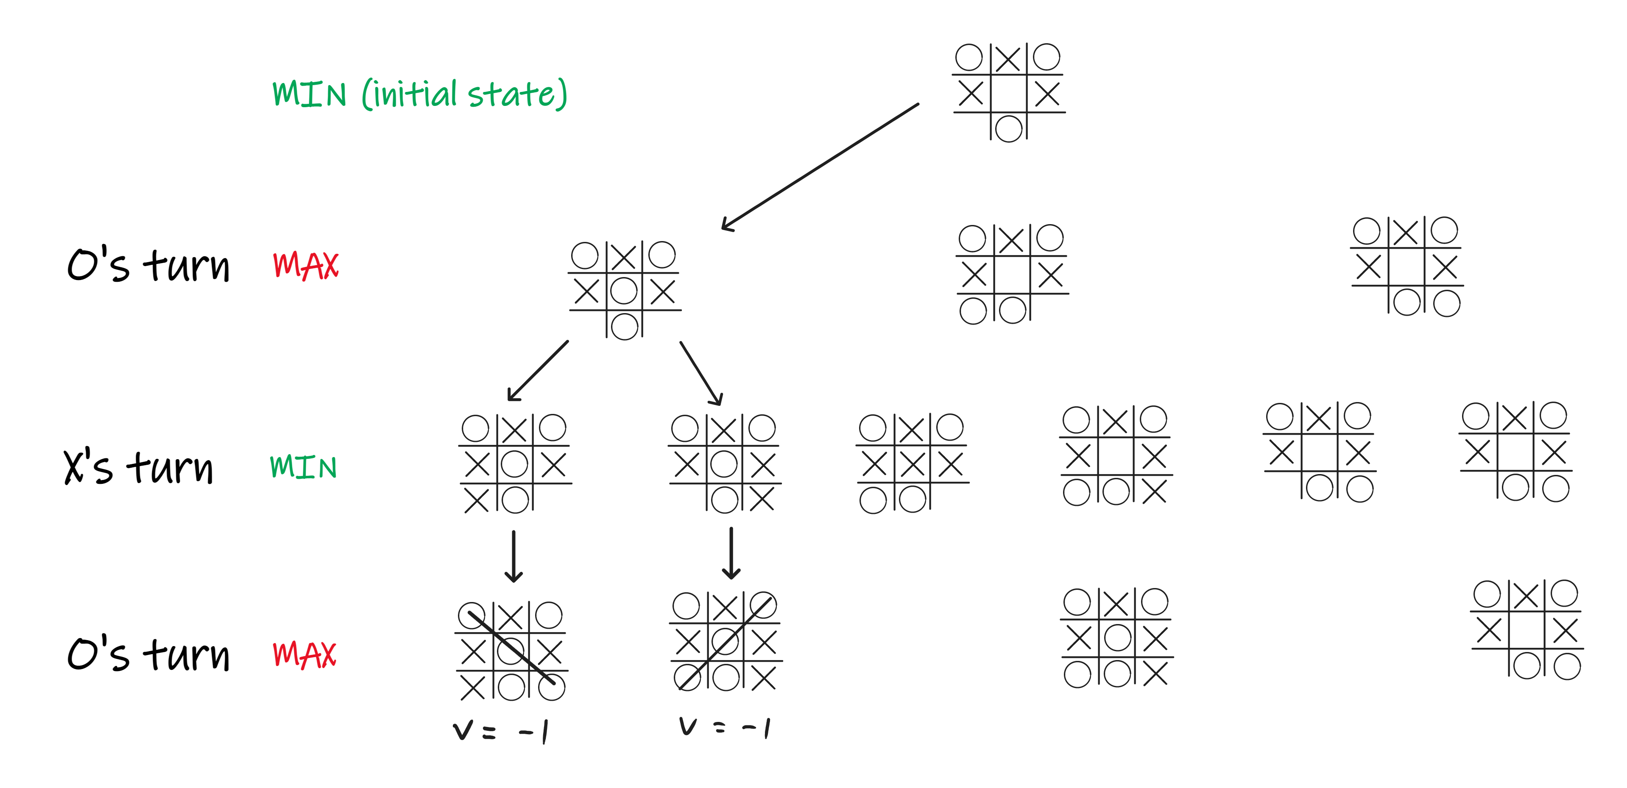
Creating an AI opponent
Project 01
002
By using
Agent Minimax
class AgentMinimax:
...
def minimax(self, board, maximizing):
...
# X's turn
if maximizing:
max_eval = -100
best_move = None
valid_moves = board.valid_moves
for move in valid_moves:
temp_board = copy.deepcopy(board)
temp_board.mark_down(move, 1)
eval = self.minimax(temp_board, False)[0]
if eval > max_eval:
max_eval = eval
best_move = move
return max_eval, best_move
...
...
class AgentMinimax:
...
def minimax(self, board, maximizing):
...
# O's trun
elif not maximizing:
min_eval = 100
best_move = None
valid_moves = board.valid_moves
for move in valid_moves:
temp_board = copy.deepcopy(board)
temp_board.mark_down(move, 2)
#temp_board.display_board()
eval = self.minimax(temp_board, True)[0]
if eval < min_eval:
min_eval = eval
best_move = move
return min_eval, best_move
...

Slide 41
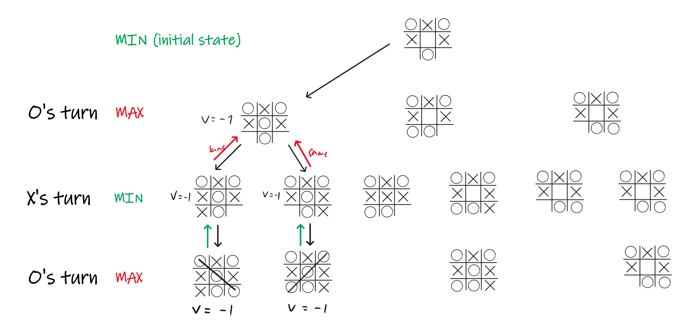
Creating an AI opponent
Project 01
002
By using
Agent Minimax
class AgentMinimax:
...
def minimax(self, board, maximizing):
...
# X's turn
if maximizing:
max_eval = -100
best_move = None
valid_moves = board.valid_moves
for move in valid_moves:
temp_board = copy.deepcopy(board)
temp_board.mark_down(move, 1)
eval = self.minimax(temp_board, False)[0]
if eval > max_eval:
max_eval = eval
best_move = move
return max_eval, best_move
...
...
class AgentMinimax:
...
def minimax(self, board, maximizing):
...
# O's trun
elif not maximizing:
min_eval = 100
best_move = None
valid_moves = board.valid_moves
for move in valid_moves:
temp_board = copy.deepcopy(board)
temp_board.mark_down(move, 2)
#temp_board.display_board()
eval = self.minimax(temp_board, True)[0]
if eval < min_eval:
min_eval = eval
best_move = move
return min_eval, best_move
...

Slide 42
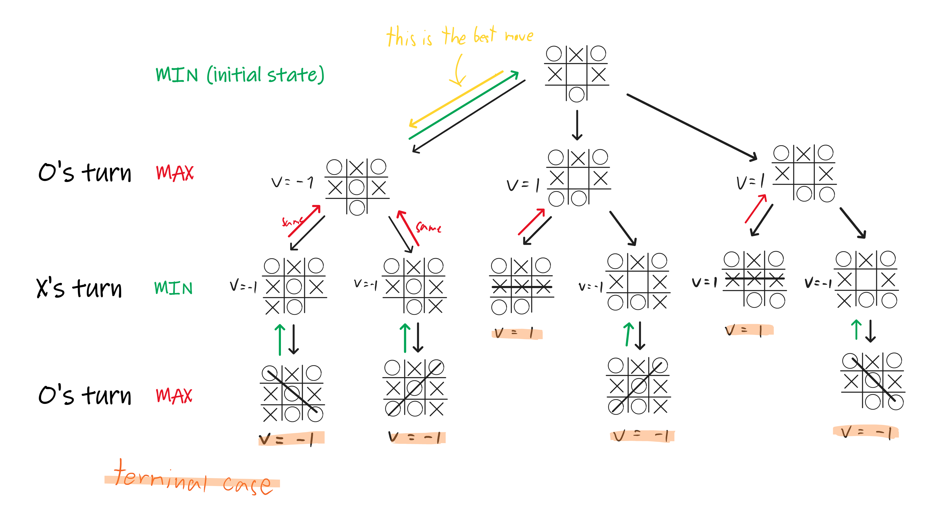
Creating an AI opponent
Project 01
002
By using
Agent Minimax
class AgentMinimax:
...
def minimax(self, board, maximizing):
...
# X's turn
if maximizing:
max_eval = -100
best_move = None
valid_moves = board.valid_moves
for move in valid_moves:
temp_board = copy.deepcopy(board)
temp_board.mark_down(move, 1)
eval = self.minimax(temp_board, False)[0]
if eval > max_eval:
max_eval = eval
best_move = move
return max_eval, best_move
...
...
class AgentMinimax:
...
def minimax(self, board, maximizing):
...
# O's trun
elif not maximizing:
min_eval = 100
best_move = None
valid_moves = board.valid_moves
for move in valid_moves:
temp_board = copy.deepcopy(board)
temp_board.mark_down(move, 2)
#temp_board.display_board()
eval = self.minimax(temp_board, True)[0]
if eval < min_eval:
min_eval = eval
best_move = move
return min_eval, best_move
...

Slide 43
Creating an AI opponent
Project 01
002
By using
Agent Minimax
class AgentMinimax:
...
def minimax(self, board, maximizing):
...
# X's turn
if maximizing:
max_eval = -100
best_move = None
valid_moves = board.valid_moves
for move in valid_moves:
temp_board = copy.deepcopy(board)
temp_board.mark_down(move, 1)
eval = self.minimax(temp_board, False)[0]
if eval > max_eval:
max_eval = eval
best_move = move
return max_eval, best_move
...
...
class AgentMinimax:
...
def minimax(self, board, maximizing):
...
# O's trun
elif not maximizing:
min_eval = 100
best_move = None
valid_moves = board.valid_moves
for move in valid_moves:
temp_board = copy.deepcopy(board)
temp_board.mark_down(move, 2)
#temp_board.display_board()
eval = self.minimax(temp_board, True)[0]
if eval < min_eval:
min_eval = eval
best_move = move
return min_eval, best_move
...

Slide 44
Creating an AI opponent
Project 01
002
By using
Agent Minimax
class AgentMinimax:
...
def minimax(self, board, maximizing):
...
def eval(self):
main_board = copy.deepcopy(self.board)
# avoid the large number of recursion when play first as X by using random
if len(main_board.valid_moves) == 9:
move = random.choice(main_board.valid_moves)
else:
# Determine if Agent is trying to maximize or minimize the score
maximizing = True if self.player == 1 else False
eval, move = self.minimax(main_board, maximizing)
return move

Slide 45
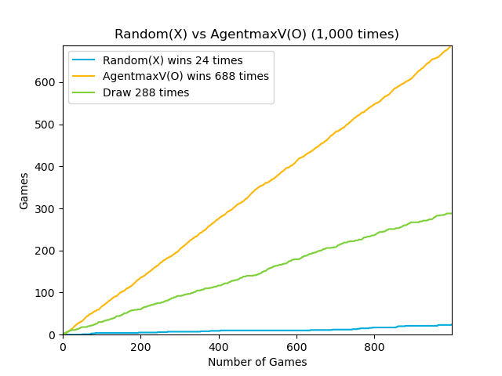
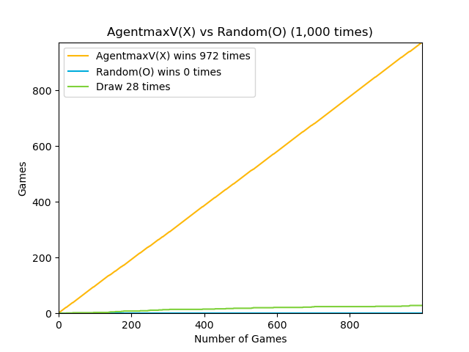
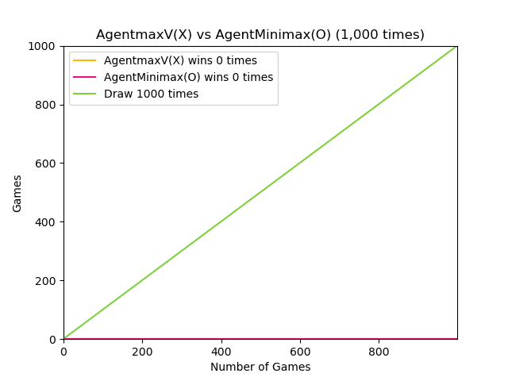
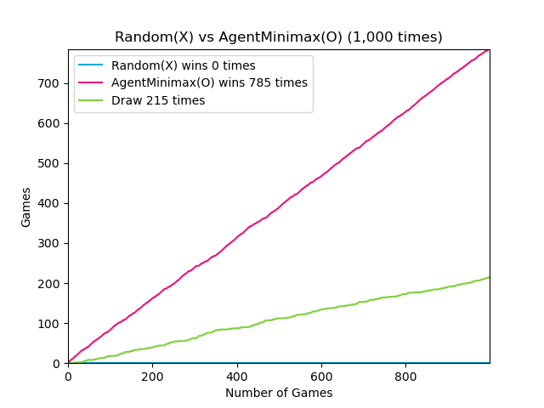
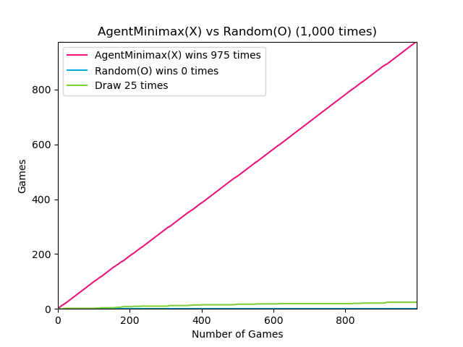
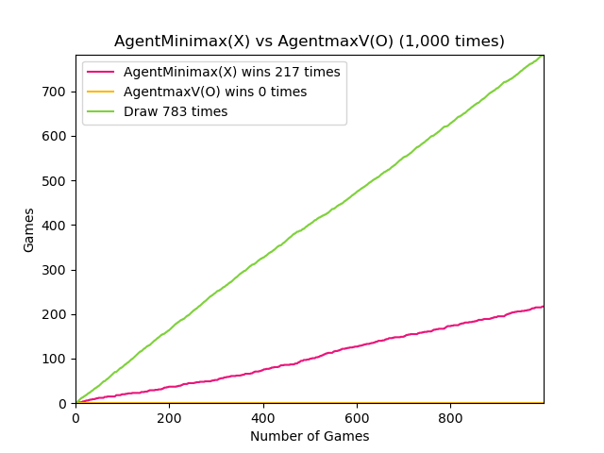
Testing the Efficacy of The AI
Project 01
003
Random vs AI
AI vs Random
AI vs AI

Slide 46


Deployment The Game to Web
Project 01
004
using Flask framework with HTML and CSS to deploy our game to web

